Slide 1
Welcome!

Slide 2
Math Lesson 1
Intro to Decimals

Slide 3
Introduction
Name: Mike
Age: 15
Hobby: Football
I teach Maths and Science

Slide 4
Introduce yourself

Slide 5
Schedule
1) Icebreaker
2) Practice: Place Value Names
3) Practice: Value of a digit
4) 5 mins Break
5) Kahoot : TBD
6) Review: Decimal place value review
7) Checkout: How did you feel about decimals? Do you understand the basics?

Slide 6
Icebreaker
Do you know when you need to use decimals?

Slide 7
Place value names & Value of a digit
In a number, the value of each digit depends on its position, which is called place.
For example, 165 934 is called “a hundred and five thousand, nine hundred and thirty-four”. And the “1” here represents “a hundred thousand”.
Remember to use zero as a space-filler.
\ | Hundred Thousands | Ten Thousands | Thousands | Hundreds | Tens | Ones | The Whole Number
e.g. | 1 | 0 | 9 | 5 | 3 | 4 | 105 934

Slide 8
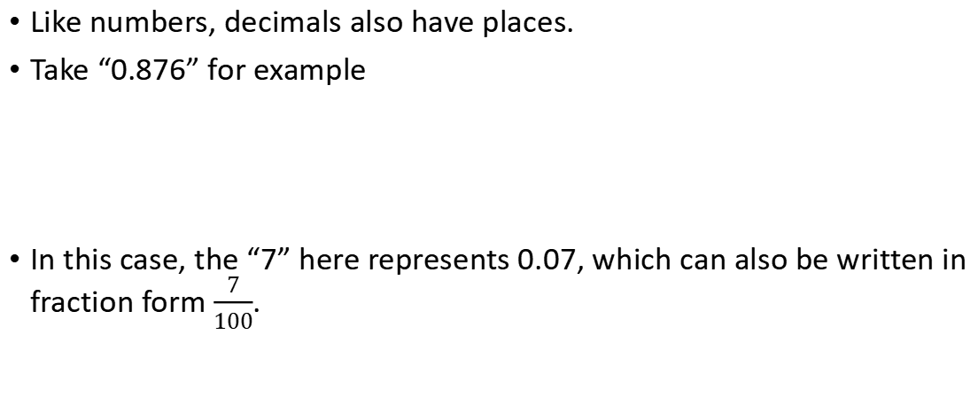
Decimal place value
Like numbers, decimals also have places.
Take “0.876” for example
In this case, the “7” here represents 0.07, which can also be written in fraction form $\frac{7}{100}$.
Ones | Tenths | Hundredths | Thousandths
0 | 8 | 7 | 6

Slide 9
Decimal in expanded form
It’s separating a deciaml into multiple parts.
For example, “3.163” in expanded form is: 3+0.1+0.06+0.003

Slide 10
Place value names - Practice
Write the following number as digits
  Eighty-nine thousand, two hundred and thirteen
  Five hundred and three thousand, two hundred and fourty
  Twenty-two thousand
Write the following number in words
  144 364
  205 967
  50 298

Slide 11
Value of a digit - Practice
What is the value of the red digit in each number
  e.g. 12 345 300
  253 645 50 000
  124 234 30
  970 798 900 000
  867 546 7000

Slide 12
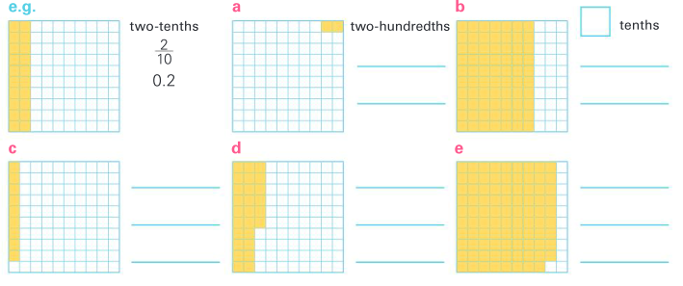





Decimal - Practice
Write the shaded part as a fraction and as a decimal
7
$$\frac{2}{100}$$
$$\frac{7}{10}$$
0.02
0.07
nine-hundredths
26 hundredths
89 hundredths
$$\frac{9}{100}$$
$$\frac{26}{100}$$
$$\frac{89}{100}$$
0.09
0.26
0.89

Slide 13
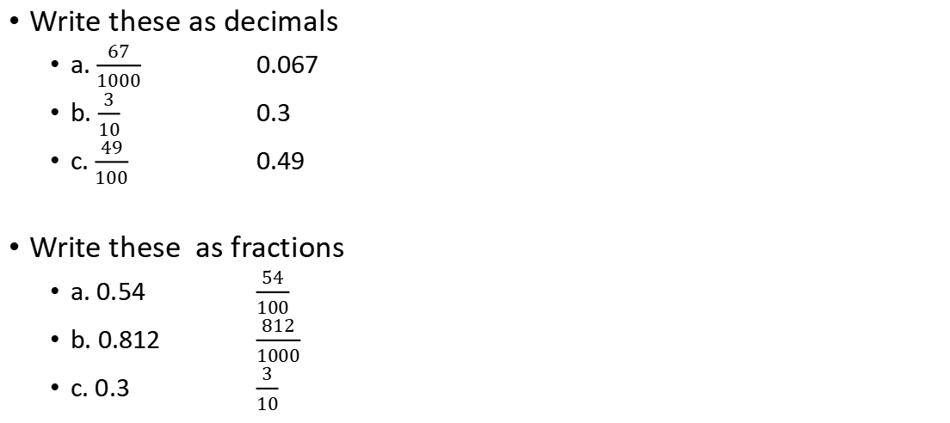
Decimals - Practice
Write these as decimals
  a. $\frac{67}{1000}$ 0.067
  b. $\frac{3}{10}$ 0.3
  c. $\frac{49}{100}$ 0.49
Write these as fractions
  a. 0.54 $\frac{54}{100}$
  b. 0.812 $\frac{812}{1000}$
  c. 0.3 $\frac{3}{10}$

Slide 14
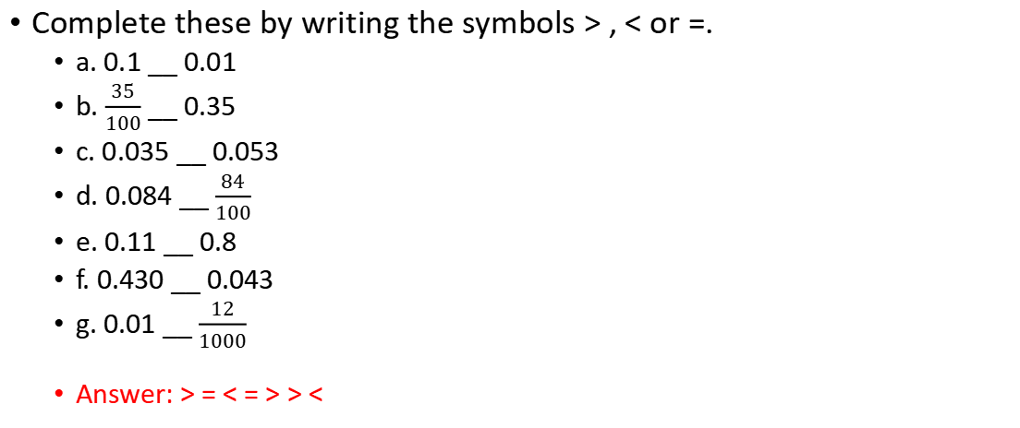
Decimals - Practice
Complete these by writing the symbols > , < or =.
  a. 0.1 __ 0.01
  b. $\frac{35}{100}$ __ 0.35
  c. 0.035 __ 0.053
  d. 0.084 __ $\frac{84}{100}$
  e. 0.11 __ 0.8
  f. 0.430 __ 0.043
  g. 0.01 __ $\frac{12}{1000}$
  Answer: > = < = > > <

Slide 15
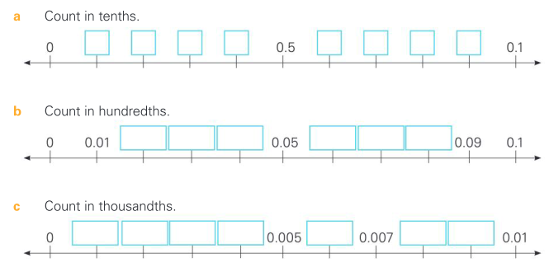
Decimals on the number line - Practice
Fill in the gaps on these decimal number lines
0.1
0.2
0.3
0.4
0.6
0.7
0.8
0.9
0.02
0.03
0.04
0.06
0.07
0.08
0.001
0.002
0.003
0.004
0.006
0.008
0.009

Slide 16
Decimals - Practice
Order these from smallest to largest
a. 0.2 0.5 0.1 0.9 0.4
b. 0.04 0.07 0.02 0.06 0.03
c. 0.007 0.004 0.008 0.002 0.001
d. 0.2 0.3 0.02 0.002 0.1
e. 0.1 0.11 0.2 0.22 0.15
f. 0.5 0.05 0.005 0.555 0.055
a 0.1, 0.2, 0.4, 0.5, 0.9
b 0.02, 0,03, 0.04, 0.06, 0.07
c 0.001, 0.002, 0.004, 0.007, 0.008
d 0.002, 0.02, 0.1, 0.2, 0.3
e 0.1, 0.11, 0.15, 0.2, 0.22
f 0.005, 0.05, 0.055, 0.5, 0.555

Slide 17
Decimals - Practice
2.51 + 3.321 = 5.831
1.3 + 0.22 = 1.52
0.005 + 0.05 = 0.055
12.3 + 1.23 = 13.53
9.998 + 0.02 = 10.018

Slide 18
Break Time
We’ll be back at 6:05 pm

Slide 19
Kahoot Quiz
Join with PIN: 04221850
Usage: visit kahoot.it and enter pin
or you can use the link https://kahoot.it/challenge/04221850

Slide 20
Review
What we’ve learned:
  Number/Decimal Places
  Place value names

Slide 21
Thank you
See you next week

